Slide 1


Digital Crisis
Landscape Analysis
Team
Client
Regional Flyer

Slide 2
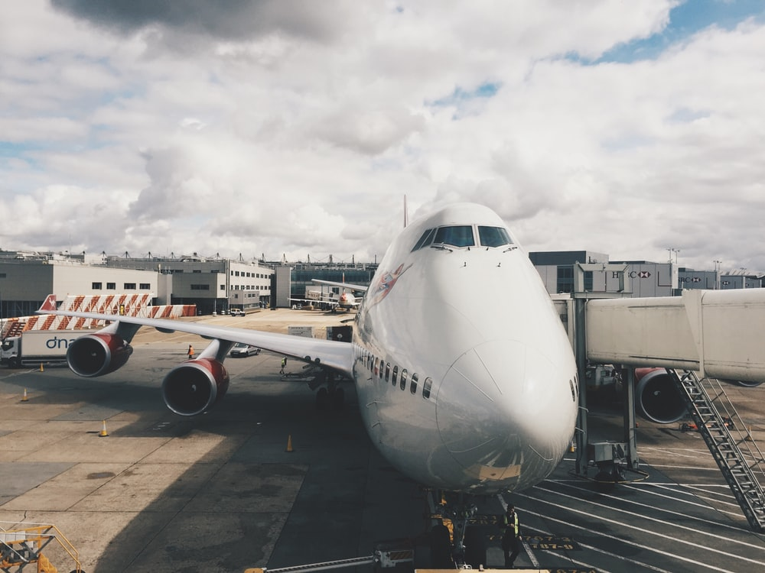
INTRODUCTION

Slide 3
Problem Statement
How can we help United Airlines manage digital crisis?
What are the red flags that the Airline must look out for to determine which Influencers and Publishers have the most influence?
What is the time window that the Airline must act within before the an incident gains traction on social media?
What are the most concerning topics of issues for United Airlines when dealing with digital crises?

Slide 4
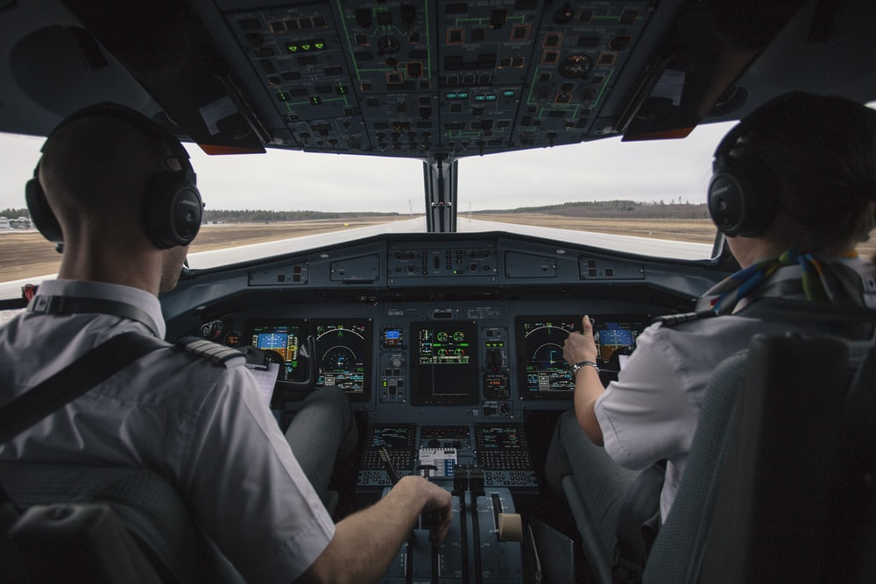
DATA PREPROCESSING

Slide 5
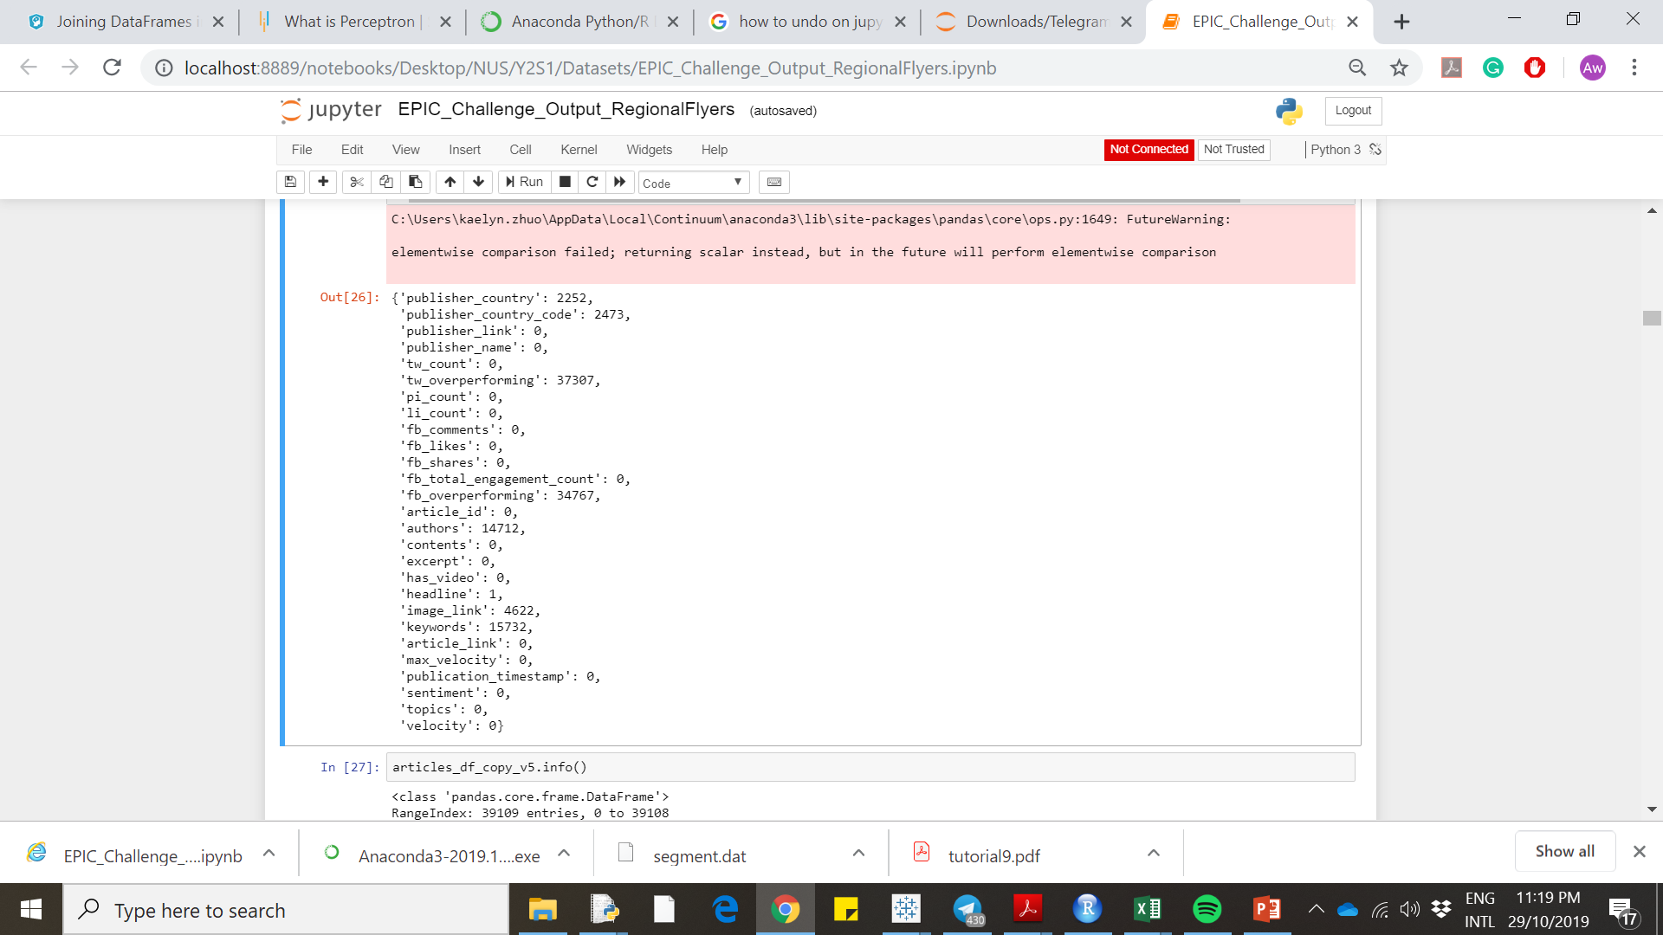
Articles Dataset
Step 1: Normalise all json columns in the Articles Dataset.
Step 2: Inspect for missing values in Articles Dataset. (Refer to Figure)
Feature Removal: As the total no of occurrence for articles_df is 39109. The high no of missing values for tw_overperforming, fb_overperforming authors, image link and keywords will not be taken into consideration for analysis

Slide 6
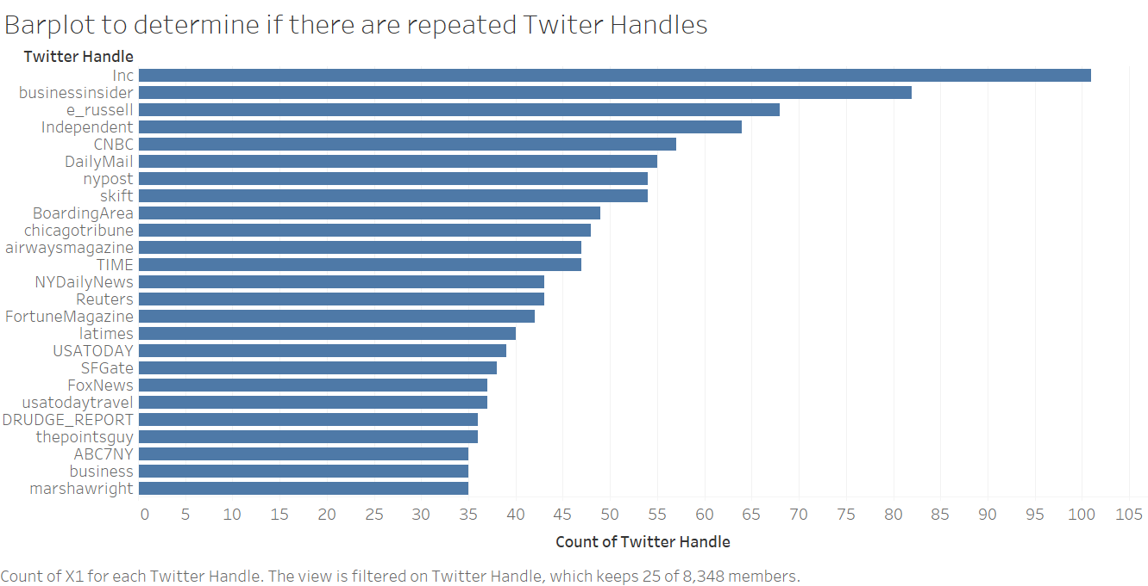
Twitter Influencer Dataset
Step 1: Normalise all json columns in the Influencer Dataset.
Step 2: Inspect for duplicates data of various twitter_handles
Bar Plot above shows that one twitter handle has many records, indicating duplicated twitter handles)

Slide 7
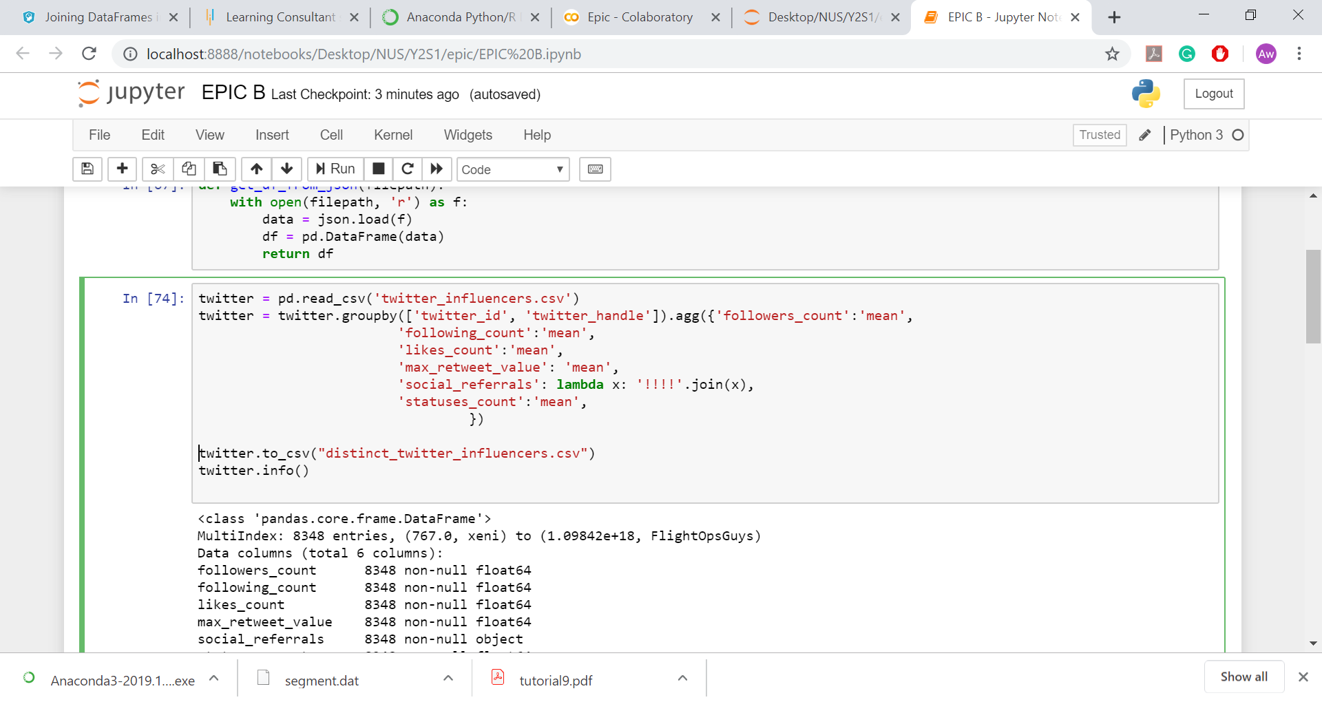
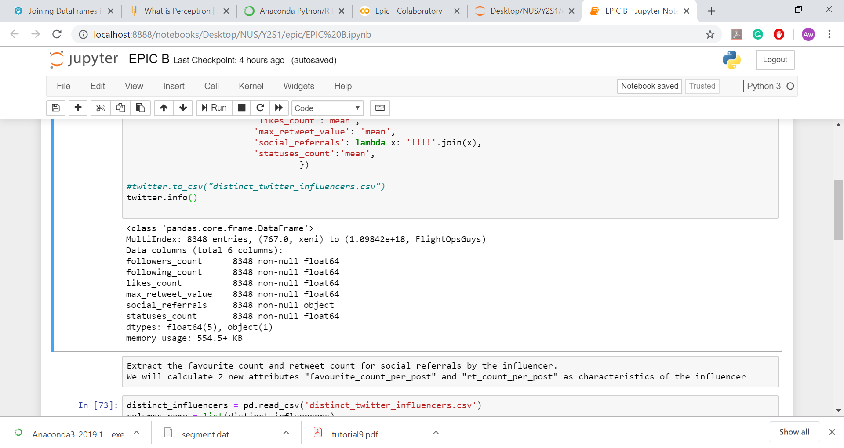
Twitter Influencer Dataset
Perform deduplication to obtain distinct Influencers
Relevant aggregation functions are applied to the various attributes to ensure no data is removed. Eg social referrals are all joined and not removed.

Slide 8
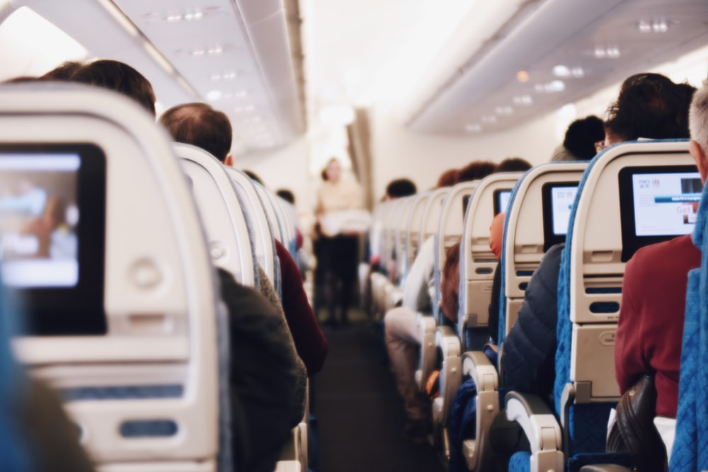
STAKEHOLDER
SEGMENTATION

Slide 9
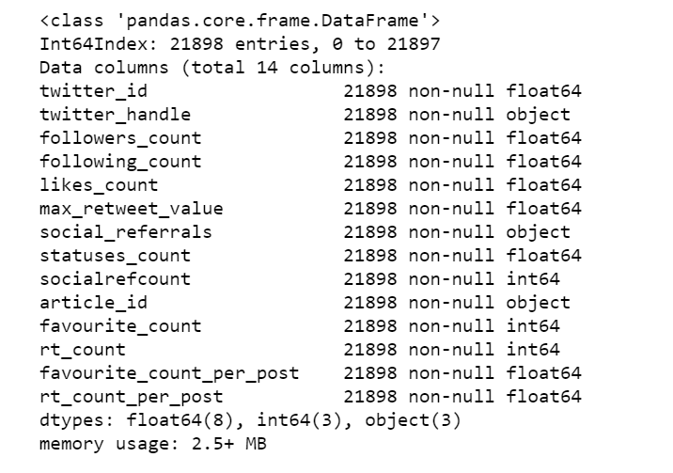
Influencer Segmentation
Algorithm Selection
Processing dataset to include the count of articles shared and favourites, retweets achieved on articles shared by influencers
Selection of relevant metrics
to run the K-Means algorithm on to segment the data points for influencers

Slide 10
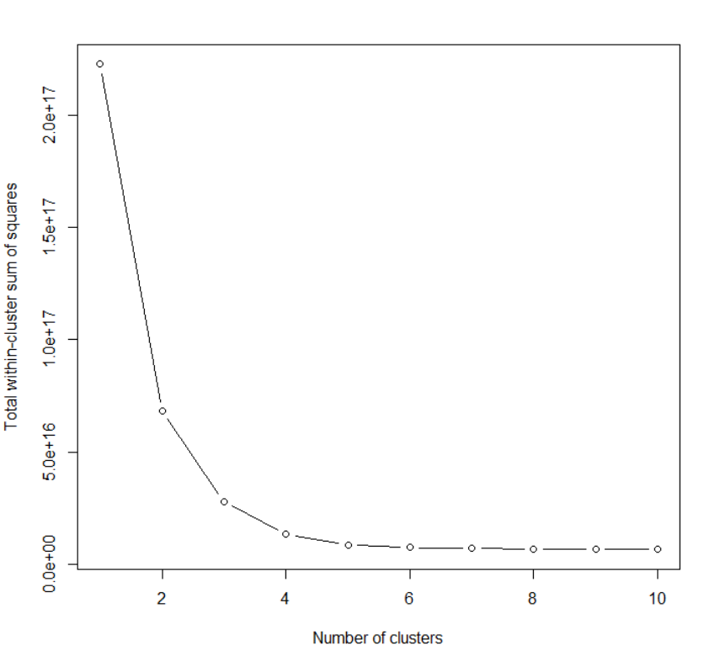
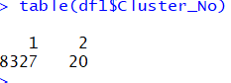
Influencer Segmentation
Hyperparameter K Tuning
Use k = 2 for first clustering iteration (Elbow Method)
Run algorithm again on those clustered as “1” as skewed clusters limits analysis scope
Generation of 4 segments, no further segmentation as doing so does not reduce data skewness

Slide 11
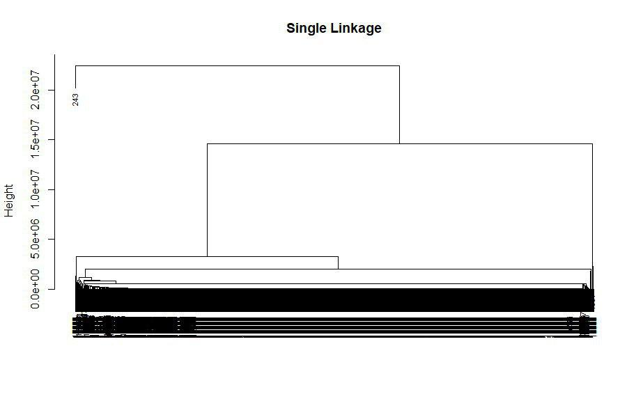
Influencer Segmentation
Choice of K-Means over Hierarchical Clustering
While Hierarchical Clustering is better for skewed datasets, the resulting dendrogram still shows a high degree of skewness in the resultant clusters → Inappropriate method for clustering

Slide 12
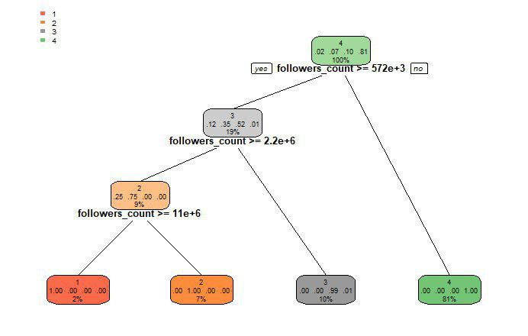
Influencer Segmentation
Decision Tree Generation
Decision Tree shows us that the most significant difference between the 4 segments would be the influencers’ followers_count

Slide 13


Influencer Segmentation
Determining Characteristics of Different Segments
As the Decision Tree characterised the different segments only by one attribute, it was not very useful.
Thus we decided to compare the median of the various attributes for the different segments and conducted a hypothesis test (using Tukey HSD test) to determine whether the difference between the 2 segments for a specific attribute was significant.
H = High, M = Medium, L = Low, VL = Very Low

Slide 14
Influencer Segmentation
Characteristics of Different Segments
Segment | 1 | 2 | 3 | 4
Followers_Count | H | M | L | VL
Following_Count | VL | L | M | H
Likes_count | VL | L | M | H
Max_retweet_value | H | M | L | VL
Statuses_count | H | M | L | VL
Socialrefcount | M | H | L | VL
Favourite_count_per_post | H | M | L | VL
Rt_count_per_post | H | M | L | VL
Insignificant difference at 95% level of significance

Slide 15
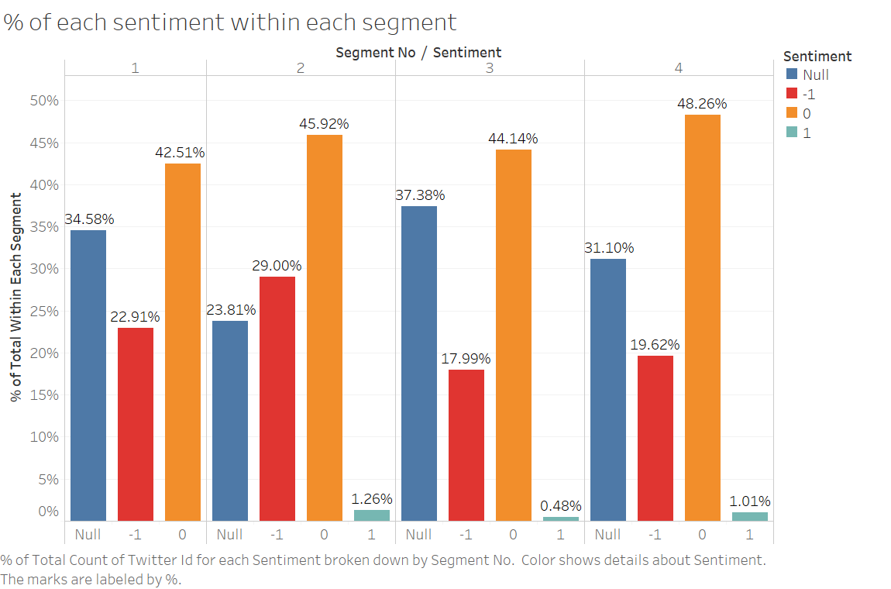
Influencer Segmentation
Sentiment Analysis Within Segments
Generally, within each segment, sentiments for most articles tweeted are neutral followed by negative.
All segments generally lack articles with positive sentiments. This shows the extent of negative emotions towards United Airlines.

Slide 16
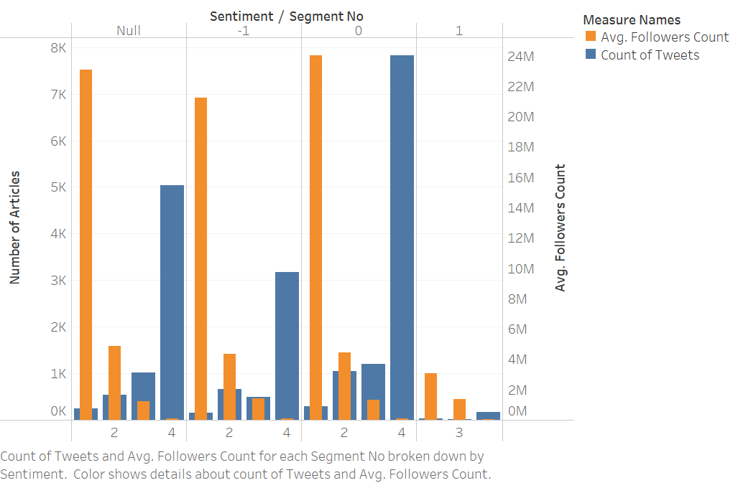
Influencer Segmentation
Sentiment Analysis Within Segments
Most tweets with negative sentiments are from segment 4. However it will be inaccurate to just look at the number of tweets from each segment as the segments greatly differ in size.
Segment 4 has the largest (size = 7974) size while Segment 1 has the smallest (size = 20) size, but segments 1 and 2 have the most number of average followers as compared to segment 4 → Count is not an accurate measure.
Use percentage of various sentiments within each segment to compare the sentiments across different segments → target segments 1 and 2 during a digital crisis.

Slide 17
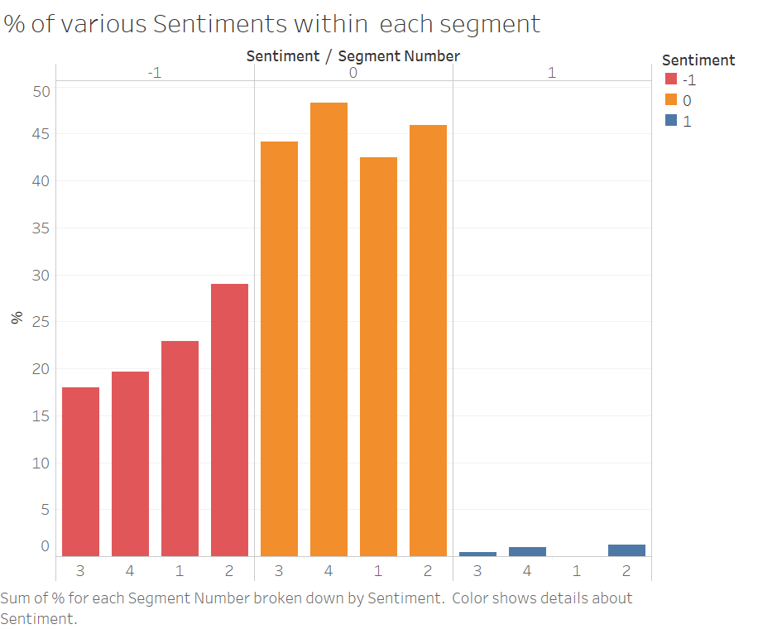
Influencer Segmentation
Sentiment Analysis Within Segments
Evaluating the tweets in the social_referrals columns and the articles mentioned, sentiments of tweets shared by influencers are extracted.
The percentage of articles with different sentiments within a specific segment is calculated and plotted against other segments with similar sentiments.
(Percentage is used as the size of the different segments differ greatly and would cause inaccurate analysis.)
Segment 1&2, many people are tweeting articles with negative sentiments and those in segment 1 are not even tweeting anything with positive sentiments at all.

Slide 18
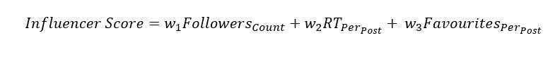
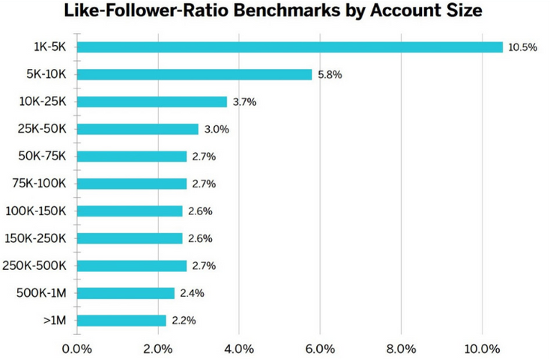
Finding Top Influencer
Likes to Follower ratio varies by Account Size, as the larger an account, the less likely they are able to engage a large percentage of their audience. Thus using followers count as a metric alone is insufficient.
Using the ratio benchmarks as a guide, for influencers with different of followers, we calculated suitable weights w to derive an “Influencer score” based on the influencer’s following and favourites and retweets per post about United Airlines.
Standardize these 3 metrics to ensure same units
Source: InfluencerDB, 2019

Slide 19
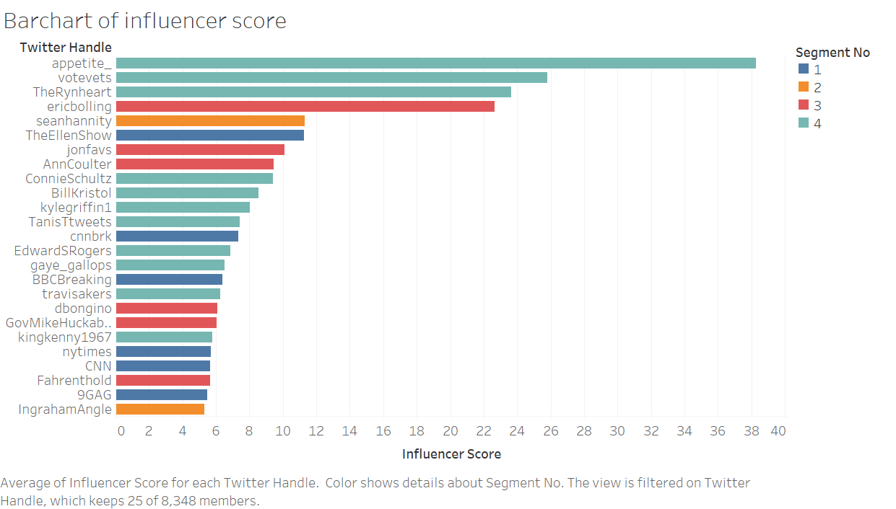
Finding Top Influencer
As we are not determining top influencers purely based on followers count and we are placing a higher weightage for retweet and likes, it results in those in Segment 4 (those that have the least followers) having high scores.
→ due to their tweets going viral despite their low follower count, which is extremely common on Twitter.

Slide 20
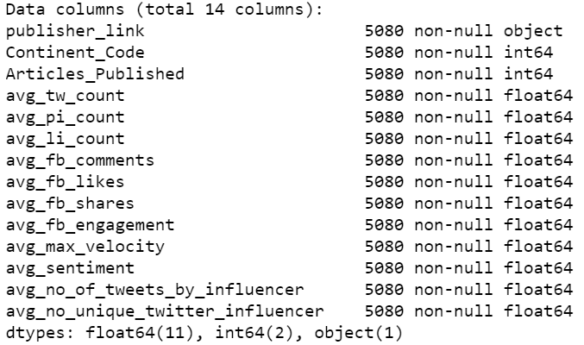
Publisher Segmentation
Algorithm Selection
Grouping articles dataset by publisher and joining dataset to get the number of influencers that shared it
Selection of relevant metrics to run the K-Means algorithm on to cluster the data points

Slide 21
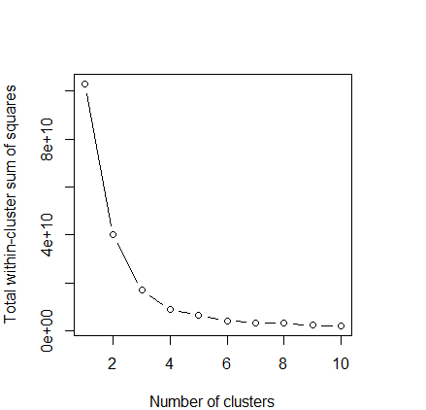
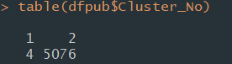
Publisher Segmentation
Hyperparameter K Tuning
Use k = 2 for first clustering iteration (Elbow Method)
Run algorithm again on those in cluster 1 as skewed clusters limits meaningful analysis
Generation of 4 clusters, no further segmentation as further segmentation does not reduce skewness of data

Slide 22
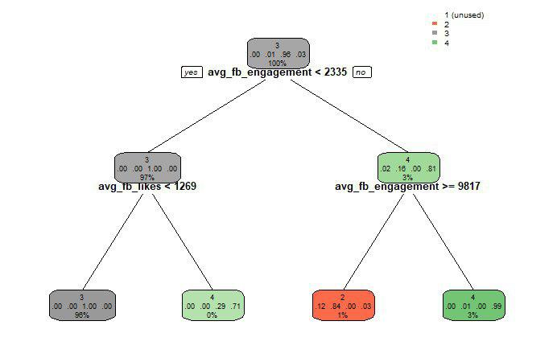
Publisher Segmentation
Decision Tree Generation
Publishers in Cluster 2 tend to have greater than 9817 engagements
Publishers in Cluster 3 have greater than 2335 engagements and more than 1269 likes
Publishers in Cluster 4 tend to have lower than 2335 engagements

Slide 23
Publisher Segmentation
Characteristics of Different Segments
Metrics | 1 | 2 | 3 | 4
Continent_Code | VL | H | L | M
Articles_Published | VL | L | M | H
Avg_tw_count | H | M | L | VL
Avg_pi_count | H | M | L | VL
Avg_li_count | H | M | L | VL
Avg_fb_comments | VL | H | M | L

Slide 24
Publisher Segmentation
Characteristics of Different Segments
Avg_fb_likes | VL | H | M | L
Avg_fb_shares | VL | H | M | L
Avg_fb_engagement | H | M | L | VL
Avg_max_velocity | H | M | L | VL
Avg_sentiment (Most -ve as H) | VL | L | H | M
Avg_tweets_by_influencer | H | M | L | VL
Avg_unique_influencers_count | H | M | L | VL
Insignificant difference at 95% level of significance

Slide 25
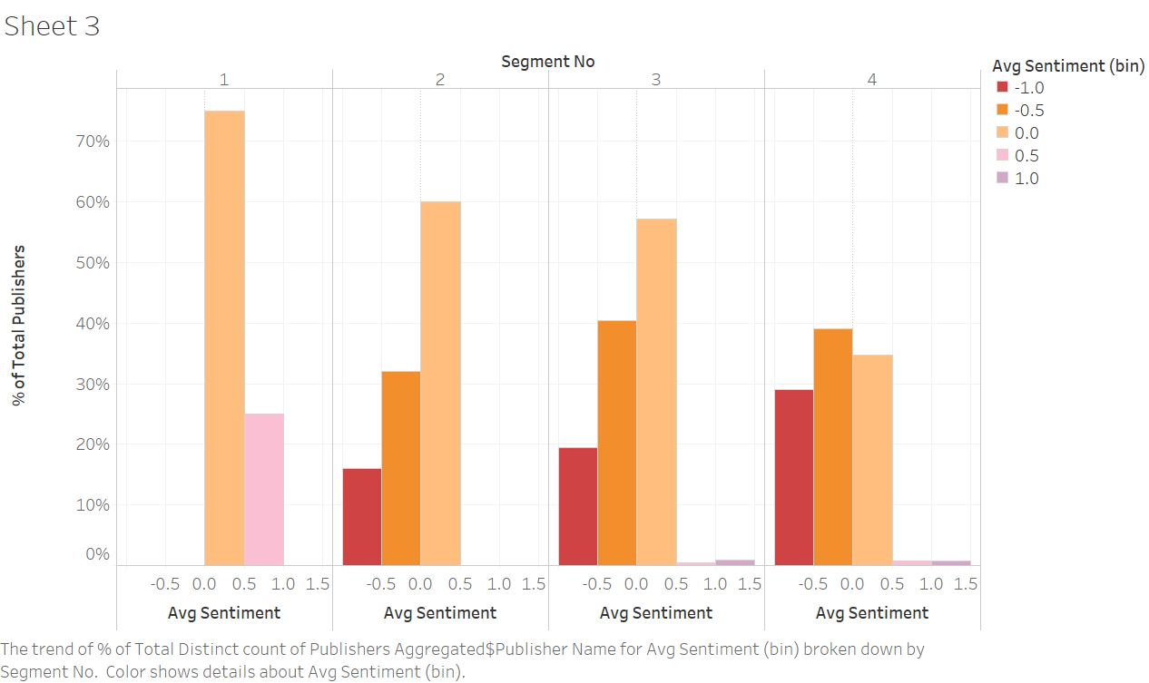
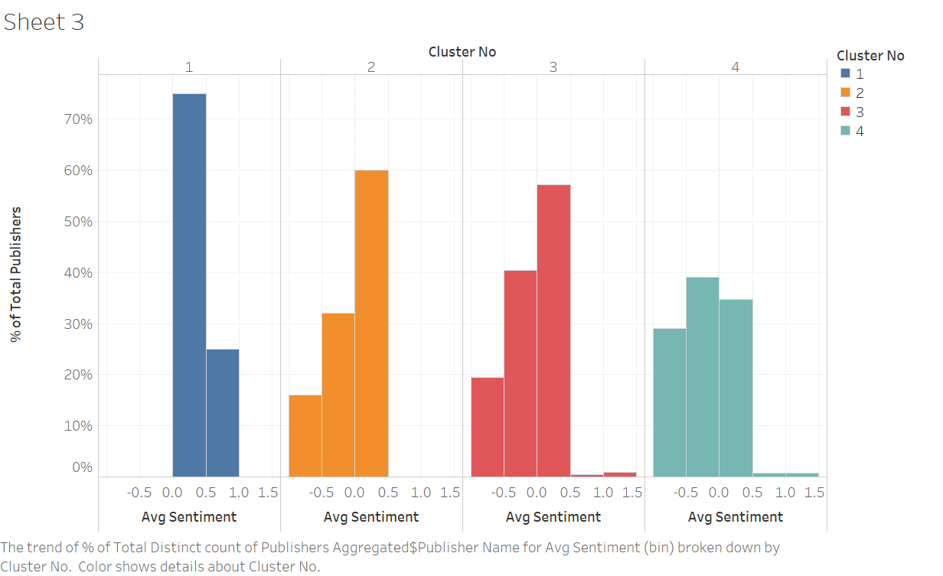
Publisher Segmentation
Sentiment Analysis Within Segments
We can see that with the exception of segment 1, for most segments, the data is skewed to the right where a large percentage of each segment has negative-neutral sentiments. We can also see that segment 1 tends to share articles with a positive sentiment about the Airline, which can be due to the Airline’s PR efforts towards this segment

Slide 26
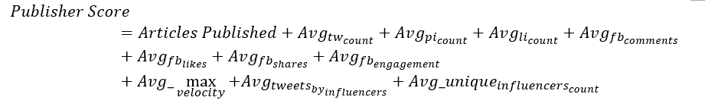
Finding Top Publishers
Since we have limited information on the suitable weights to assign the metrics, we normalised all the attributes and added the normalised values together to generate a Publisher Score
This does not take into account Average Sentiment and Continent as we believe that these 2 attributes should not have an influence on whether a Publisher is considered a top publisher or not

Slide 27
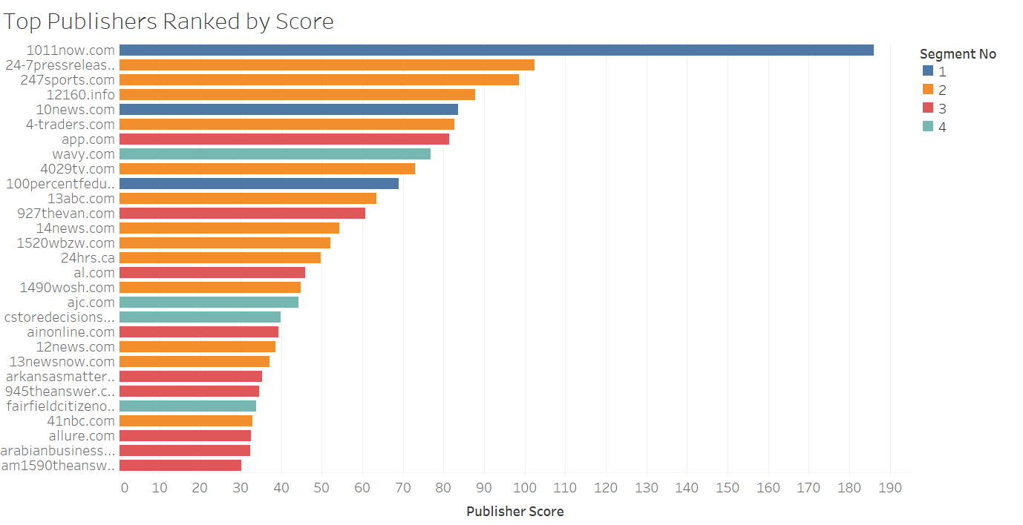
Finding Top Publishers
We can see that the top publishers are mostly from segments 1 and 2 (many followers, engagement and sharing by influencers). As publishers in segment 1 tend to publish articles with a positive sentiment, there is less need to focus PR efforts in this area. It is more important for the airline to target those in cluster 2 and 3, who rank highly in terms of publisher score (and hence influence) and are sharing negative articles about the airline

Slide 28

CONTENT
SHARING PATTERN

Slide 29
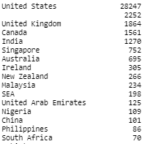
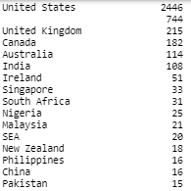
General Publisher Syndication Patterns
Geographical Syndication Distribution
Top 15 Publisher Origins on Article Level
Article Level: majority of the articles are published in United States (73% out of 39109 articles) followed by other developed and developing countries in different continents (United Kingdom, Canada, India, Singapore etc)
Publisher Level: 2446 publishers located in United States, followed by UK, Canada, India, Ireland etc. A small no of publishers locates in SEA and Afican Region
Geographical syndication may signify a strong relationship with the current flight network for United Airlines (e.g. main hub airports locates in US)
Top 15 Publisher Origins
on Publisher Level
*Reference: United Airlines Destinations, United Airline Route Map

Slide 30
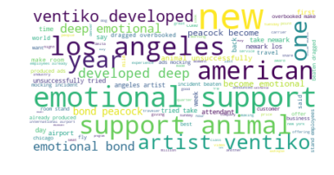
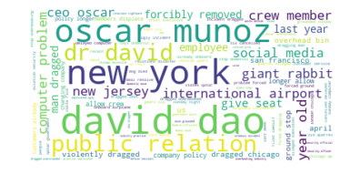
General Publisher Syndication Patterns
Excerpt Text Analysis
Top Words from Excerpt Positive Sentiments
To understand whether the content published by publishers has a similar trend which contributed to sentiment level:
Top Positive Words:
Has a strong inclination towards animal welfare (Artist Ventiko and Peacock incident), emotions (emotional, deep bond etc) and locations (Los Angeles)
Top Negative Words:
Generally associated with location (New York), flight incident (David Dao), United Airlines professionals (CEO Oscar Munoz, crew members)
Top Words from Excerpt Negative Sentiments

Slide 31
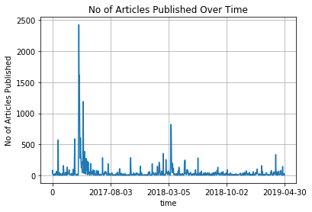
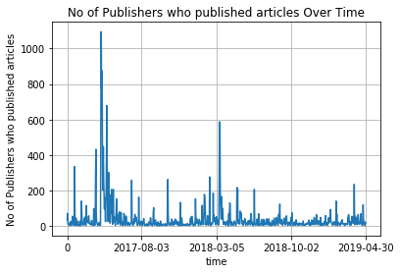
General Publisher Syndication Patterns
Time Series Analysis with Article No and Publisher No
No of articles published & no of publishers involved generally follow the same trend with spikes in similar time period
Spikes are generally associated with key incidents such as:
April 2017: United Express Flight 3411 Incident with David Dao
May 2018: Dead Dog Incident in Overhead Bin
Jan 2018: Emotional Support Peacock Board Plane
These incidents generally associates with flight policy → United Airline need to relook into policies in these areas (animal welfare, crew experience)

Slide 32
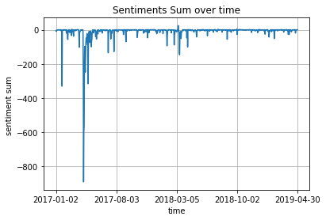
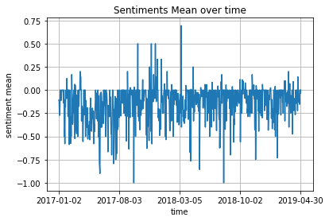
General Publisher Syndication Patterns
Time Series Analysis with Sentiments
Sentiment Sum
Strong negative sentiments are highly linked to the flight incidents mentioned earlier as the higher the no of articles published, the more negative the sentiments
Sentiment Mean
Mean Sentiment shows more consistent trend across both +ve and –ve sentiments
In general, article sentiment level lean towards negative across the whole time period

Slide 33
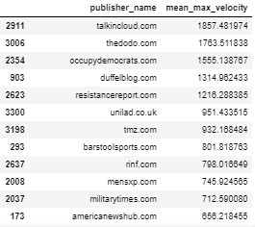
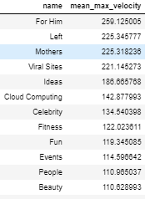
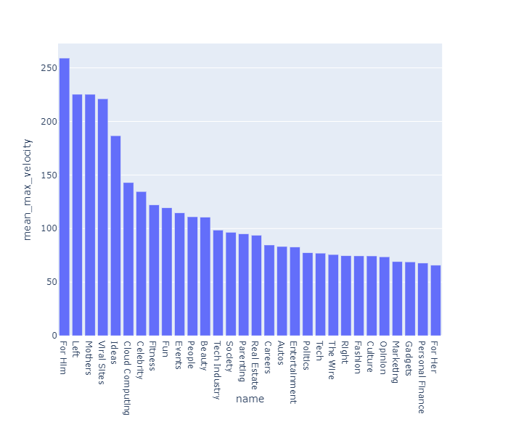
General Publisher Syndication Patterns
Social Velocity Analysis
Publisher Level
Topic Level
Max Velocity is used instead of current velocity as current velocity only considered the velocity as of April 2019
Publisher Level: Publisher with higher average max velocity are mostly viral/animal welfare/political sites
Topic Level: Top publisher generally published gender (Him, Mothers), politics (Left), Viral contents etc

Slide 34
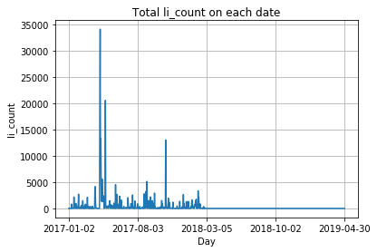
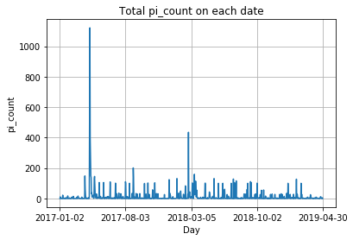
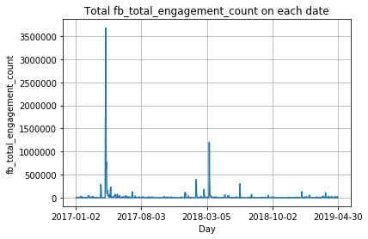



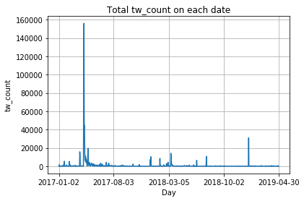

General Articles Propagation Pattern
Static Pattern on various Social Media Platform
To analyse the social media outreach generated by the articles over time:
Twitter and Facebook are the most powerful social media platforms unlike Linkedin and Pinterest
Facebook Likes, Comments and Shares are not fully accurate due to high % of zero datapoints before March 2018
Both Twitter and Facebook Total Engagement Count shows similar trends with spikes as the time series analysis with articles no

Slide 35
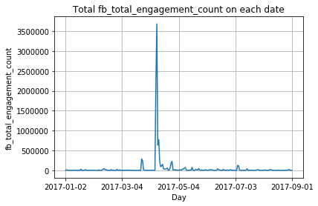
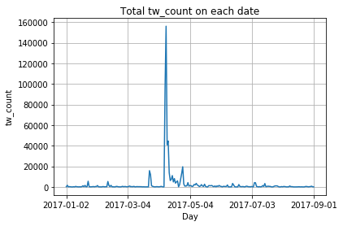
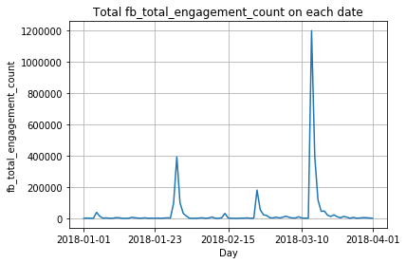
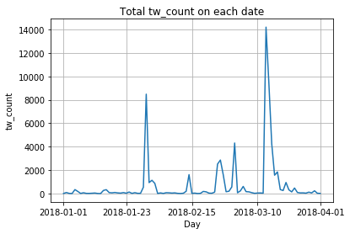
General Articles Propagation Pattern
Static Pattern on various Social Media Platform
By narrowing down to time periods with spikes:
- Social Media impact is highest during the time periods with key incidents related to United Airlines

Slide 36
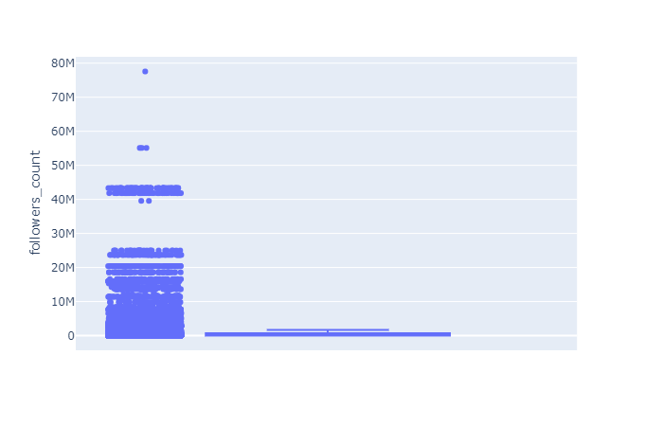
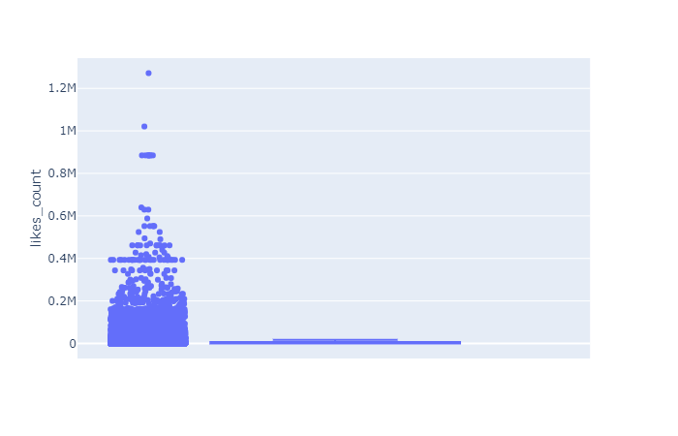
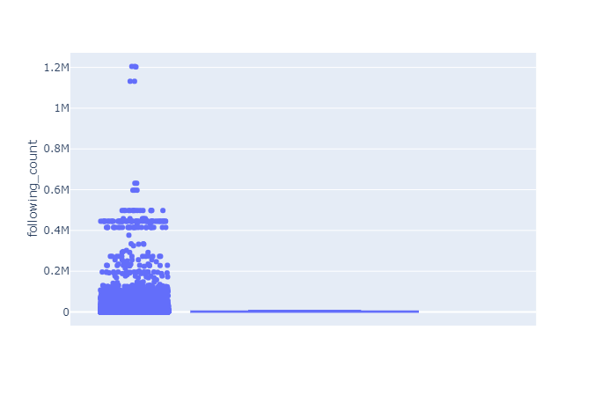
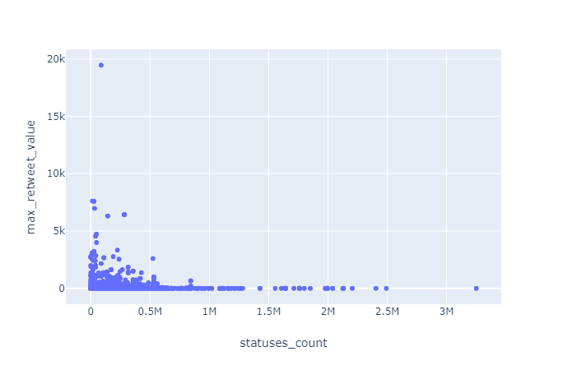
General Popular Tweets Propagation Pattern
Twitter Profile Influencer Analysis
Follower Count, Likes Count, Following Count for the Influencers are highly skewed with some extreme outliers (narrow boxplot)
Scatter Plot for Max Retweet Value with Status Count:
A few outliers (highly influencers) has low status count but high retweet values
Generally most influencers have proportional status count and retweet values (but generally > 0.5M status count & <5K retweet values)

Slide 37
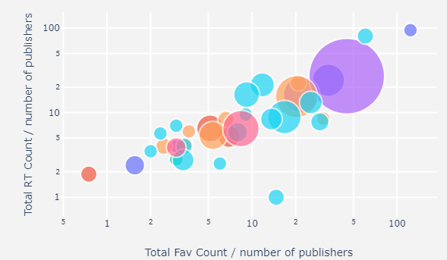
General Popular Tweets Propagation Pattern
Twitter Influencer Location Distribution
X axis: Total Favourite Count / Publisher No
Y axis: Total Retweet Count/Publisher No
Colour of Bubble Plot: Continent
Size of Bubble Plot: No of Publishers
United States/Guam/Qatar: high no of publishers, high fav count per tweet, high retweet count per tweet
Powerful Twitter Influencers generally situated at Asia Continent (Blue Bubbles)
Influencers are highly skewed in terms of location distribution (highlighted in RED)
*Note: Many articles that has not been tweeted by any twitter influencers (32783/39109), we will study the propagation patterns only for those articles that are being shared by the twitter influencers

Slide 38


General Popular Tweets Propagation Pattern
Top Topics by Twitter Influencers
To study topics of articles published with relation to the influencer tweets engagement level (favorite count and retweet count)
Popularity of tweets generally associated with Viral Sites, Defence, Media, Ideas, Fun and Stocks
Same analysis conclusion as publishers

Slide 39



General Popular Tweets Propagation Pattern
Social Engagement Level with Time Difference bet Publication and Tweet Time
Metrics Considered: Total Retweet Count, Total Favourite Count and Total Tweets by Twitter Influencer
Highly skewed if consider full time window: high avg time diff (witness.org) or high fav count/rt count (inc.com, fox news, New York post, New York Times)
48 Hour window is the ideal time window: High Social Engagement Level (in terms of retweet, favourite count and total tweets count

Slide 40


General Popular Tweets Propagation Pattern
Top Tweeted Articles and Time Window after Publication
Considering Top 30 Tweeted Articles:
- Total Tweets by Influencers generally concentrated within 20 hours - Total Retweets of the articles gradually accumulates in general with the exception of a few articles (drastically doubled or tripled)

Slide 41


General Normal Tweets Propagation Pattern
Tweet Content by General Users (non-influencers)
Highly Retweeted Tweet Words
Highly Favorited Tweet Words
Considering Top Tweeted Content:
The tweet content shows similar words relations with the excerpt content for the articles published
Some words with little relations to United Airlines exist (Trump, Illegal etc)
Certain words has strong relation to airline operations (Pilot, Overbooked, Time, Seat) → United Airlines should look into such issues if present

Slide 42




Specific Articles Syndication Patterns
By Publisher Segments
1
2
3
4
Topic Analysis:
Cluster 1: Political Publishers (Opinions, Right, Left, Politics etc)
Cluster 2: Corporate and Business Publishers (Media, Industries etc)
Cluster 3: Lifestyle and Entertainment Publishers (Culture, Life etc)
Cluster 4: General Publishers (mixture of topics)

Slide 43




Specific Articles Syndication Patterns
By Publisher Segments
1
2
3
4
Time Series Analysis on Sum of Sentiments:
Cluster 1: Highly segmented with low negative sentiment value
Cluster 2: Marginally negative sentiment value
Cluster 3: High article no over time and moderate negative sentiment value
Cluster 4: High article no over time and high negative sentiment value
*Note: clusters are skewed originally

Slide 44




Specific Articles Syndication Patterns
By Publisher Segments
1
2
3
4
Time Series Analysis for Total no of Articles Published:
Cluster 1: Low
Cluster 2: Moderate
Cluster 3: High Cluster 4: Extremely High

Slide 45

Specific Tweets Propagation Patterns
By Influencer Segments
Propagation Patterns by Social Engagement Level :
Cluster 1: Minimal Social Influence (Low Total Favourite Count, Retweet Count and Total Tweets)
Cluster 2: Low Social Influence
Cluster 3: Moderate Social Influence
Cluster 4: Extremely High Social Influence (High Total Favourite Count, Retweet Count and Total Tweets)
*Bubble Size: Total no of Tweets

Slide 46

GENERAL
RECOMMENDATION

Slide 47



Recommendation
Real-Time Tweets Virality Tracking Dashboard
Difficult to determine the tweets and influencers who will go viral, United Airline can invest in a real time dashboard which monitors closely tweets about the Arline that are rapidly gaining traction.
To analyse sentiments and key concerns
Address the concerns raised in these viral tweets via public statements, which are sincere, unlike their previous apology during the David Dao incident.
Facilitate crisis management in real-time
Reference: Twitter API Trends
Notes:
Top tweets and publishers have very little followers but tweets go viral

Slide 48

Recommendation
Releasing Statements with Relevant Keywords
Based on the top topics associated with the Airline, we recommend the Airline includes keywords relevant to the topics in their press releases to drive their articles up Search Engine Rankings.
While these keywords will change based on the crisis type, the Airline can do a keyword analysis within the time window to decide which keywords to include in their press statements.

Slide 49

Recommendation
Study Network Analysis of Top Influencers
United Airlines can study the network analysis of top influencers and see how they may be related to one another. This can tell us the internal relations between some of the highly influential twitter accounts.
Helps in deciding which key influencers in the network to target in order to contain the spread of the articles with negative sentiment.

Slide 50

Recommendation
Additional Social Media Content Analysis - Videos
Instead of only using social media and news article data, United Airline can also study video content on platforms such as Youtube as it is an important source for digital crisis management.
Web-scraping can be applied on Youtube comments and like-dislike figures can also be used for analysis of public sentiment.

Slide 51

CONCLUSION

Slide 52
Limitations and Constraints
Dataset Skewness
The datasets provided to us tends to be highly skewed
This causes the clustering algorithm to cluster these data points as a small cluster
This skewed cluster size limits segment analysis
Business Domain Knowledge
Weights are estimated due to limited information on business
Difficult to assign proper weightage to more important features in scoring influencers and publishers
Data Imputation would be improved with feature understanding

Slide 53
Further Improvements
Text Analytics
Analyse Publisher Profiles
We did not manage to all datapoints in our dataset (e.g article content)
We could have leveraged on text analysis on the content
Scrape more data from Wikipedia or other websites that has content on specific publishers
Data Points Enhancement
User Behaviour Study
Increase data rows and instances (especially accounts with large following) so that the clustering algorithm can generate more even datasets→ large dataset allows better understanding of Influencers and Publisher segments
Study the user behaviour mouse-clicks, time spent on website, etc as feature as well to study reception to press release

Slide 54

THANK YOU
HAVE A PLEASANT FLIGHT!

